Slide 1

Object-Oriented Software Analysis & Design (COMP-3220) Lecture 1 Introduction to Design Patterns
School of Computer Science
Faculty of Science
University of Windsor
Dr. Saeed Samet

Slide 2
Big Data Analytics and Database Design
The one constant in software development is …
Why and how we can exploit the wisdom and lessons learned by other developers who’ve been down the same design problem road and survived the trip.
We will look at the use and benefits of design patterns, look at some key object-oriented design principles, and walk through an example of how one pattern works.
Instead of code reuse, with patterns you get experience reuse.

Slide 3
Big Data Analytics and Database Design
A simple duck pond simulation game app
Joe works for a company that makes a highly successful duck pond simulation game, SimUDuck.
The game can show a large variety of duck species swimming and making quacking sounds.
The initial designers of the system used standard OO techniques and created one Duck superclass from which all other duck types inherit.

Slide 4
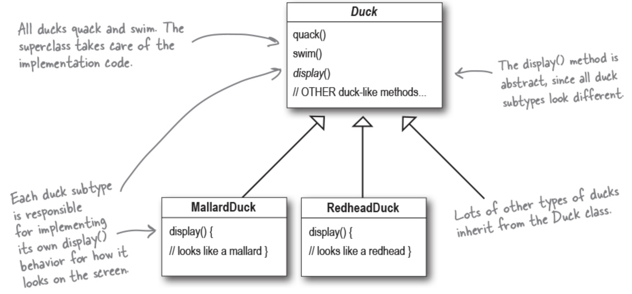
Change: Now we need the ducks to FLY.

Slide 5
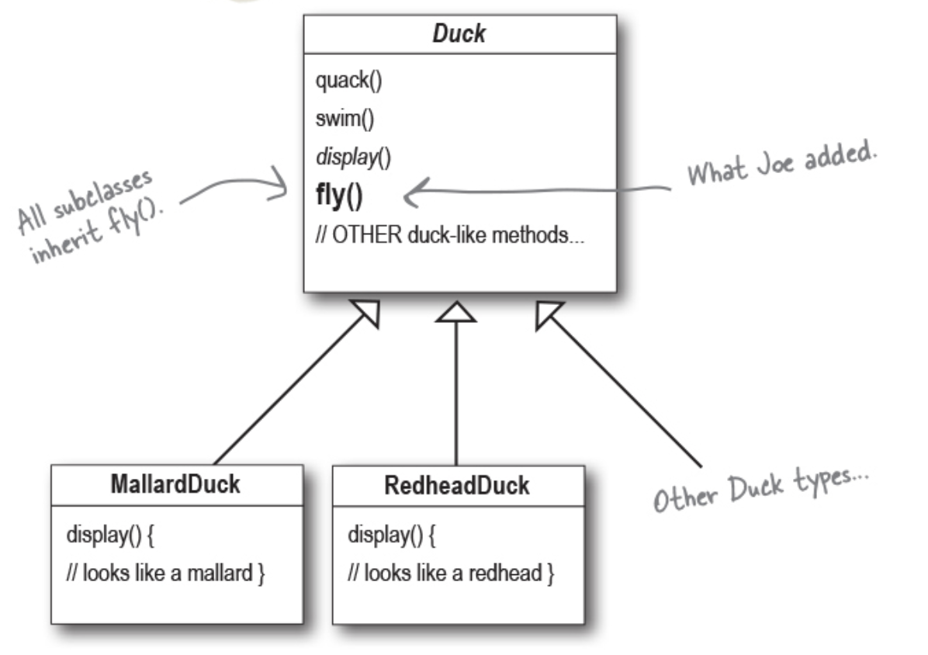
Add a fly() method in the Duck superclass, and then all the ducks will inherit it.
But something went horribly wrong ...!

Slide 6
Big Data Analytics and Database Design
What is wrong?
Joe failed to notice:
Not all subclasses of Duck should fly.
When Joe added new behavior to the Duck superclass, he was also adding behavior that was not appropriate for some Duck subclasses.
He now has flying inanimate objects in the SimUDuck program.
A localized update to the code caused a non-local side effect (flying rubber ducks)!

Slide 7
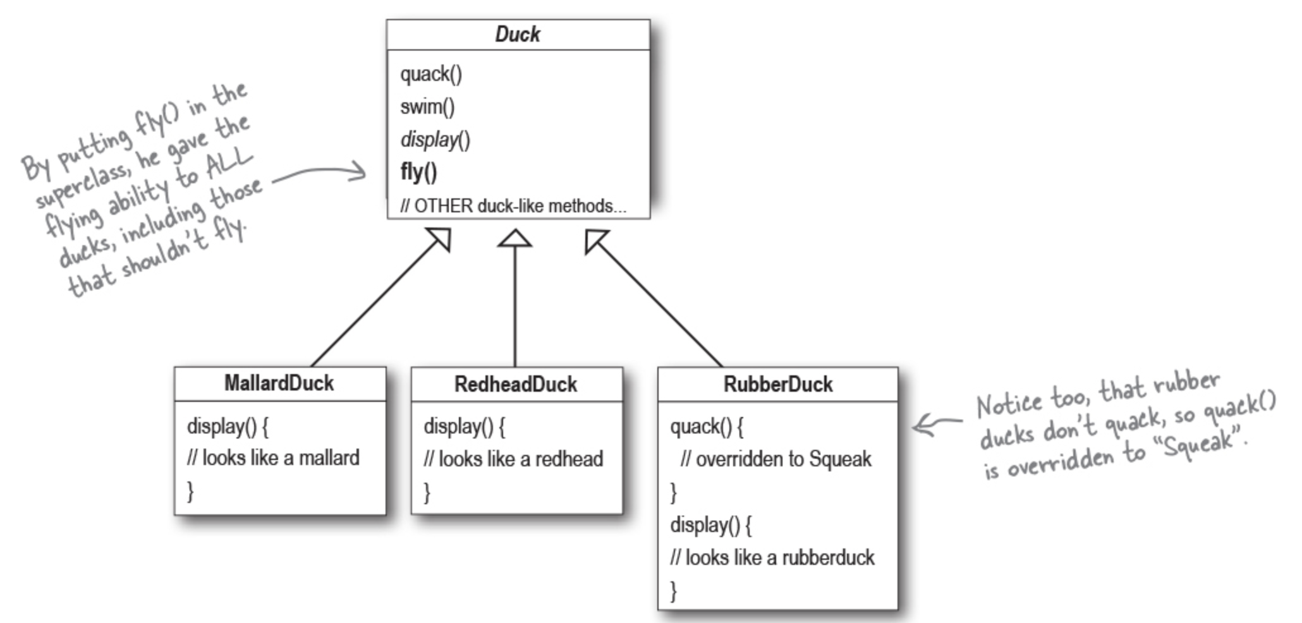
A great use of inheritance for the purpose of reuse.
Not so well when it comes to maintenance.

Slide 8
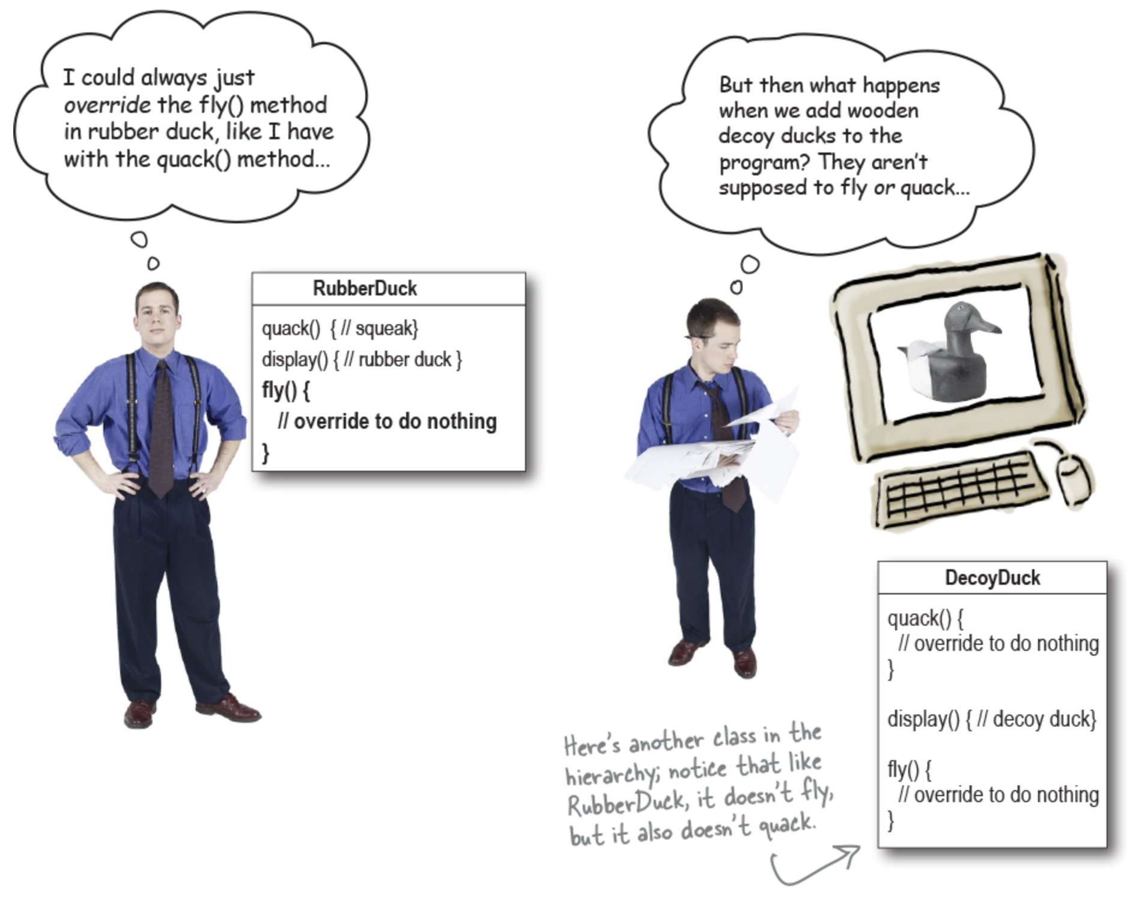

Slide 9
Big Data Analytics and Database Design
How about an interface?
Inheritance probably isn’t the answer
How about we want to update the product every six months.
The spec will keep changing and we’ll be forced to look at and possibly override fly() and quack() for every new Duck subclass that’s ever added to the program, forever.
We need a cleaner way to have only some (but not all) of the duck types fly or quack.
Take the fly() out of the Duck superclass and make a Flyable interface with a fly() method.
Only the ducks that are supposed to fly will implement that interface and have a fly() method.
Quackable interface too, since not all ducks can quack.

Slide 10
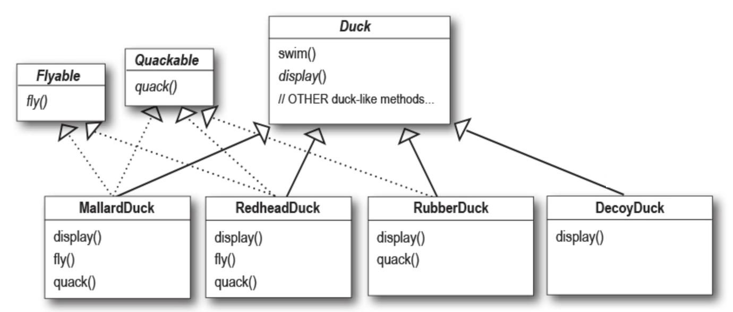
But while having the subclasses implement Flyable and/or Quackable solves part of the problem, it completely destroys code reuse for those behaviors.
It just creates a different maintenance nightmare.
And there might be more than one kind of flying behavior even among the ducks that do fly.

Slide 11
Big Data Analytics and Database Design
Software Nature
what’s the one thing we can always count on in software development?
No matter where we work, what we’re building, or what language we are programming in, what’s the one true constant that will be with you always?
No matter how well we design an application, over time an application must grow and change, or it will die.

Slide 12
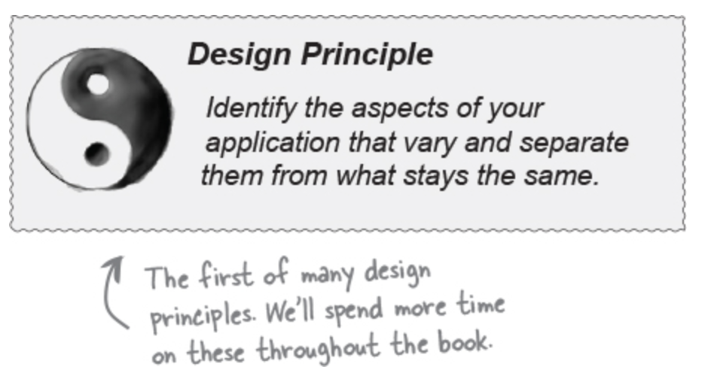
Big Data Analytics and Database Design
A Design Principle for this situation
Take the parts that vary and encapsulate them.
We can later alter or extend the parts that vary without affecting those that don’t.
It forms the basis for almost every design pattern.
Fewer unintended consequences from code changes
more flexibility

Slide 13
Big Data Analytics and Database Design
Separating what changes from what stays the same
Other than the problems with fly() and quack(), the Duck class is working well and there are no other parts of it that appear to vary or change frequently.
We create two sets of classes (totally apart from Duck)
One for fly
One for quack
Each set of classes will hold all the implementations of the respective behavior.
For instance, we might have one class that implements quacking, another that implements squeaking, and another that implements silence.

Slide 14
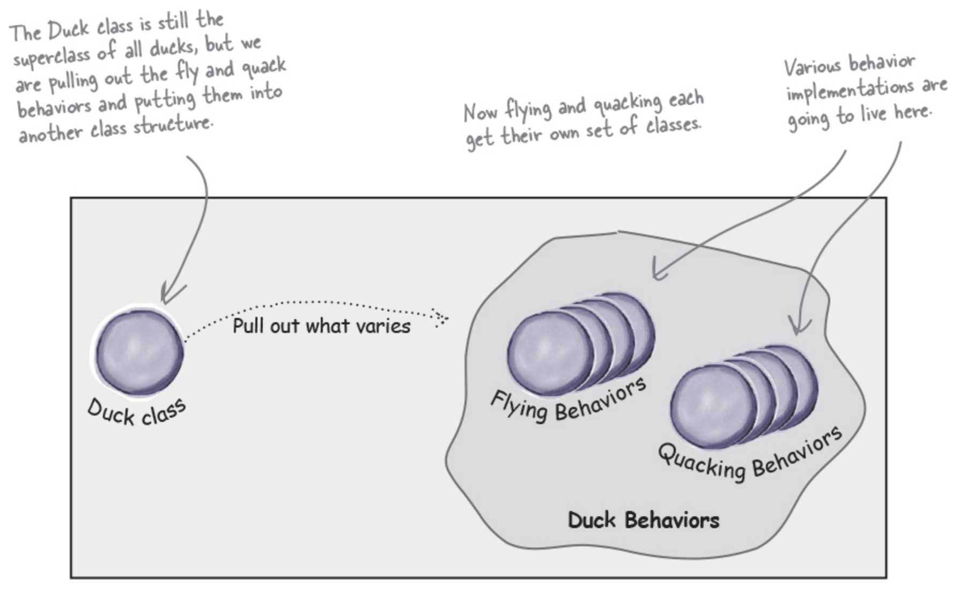

Slide 15
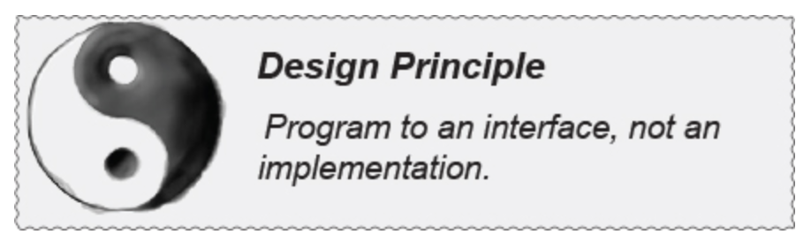
Designing the Duck Behaviors
We want to assign behaviors to the instances of Duck.
For example, we might want to instantiate a new MallardDuck instance and initialize it with a specific type of flying behavior.
And make sure that we can change the behavior of a duck dynamically. How?
By including behavior setter methods in the Duck classes so that we can change the MallardDuck’s flying behavior at runtime.
Our second design principle:
We’ll use an interface to represent each behavior—for instance, FlyBehavior and QuackBehavior—and each implementation of a behavior will implement one of those interfaces.

Slide 16
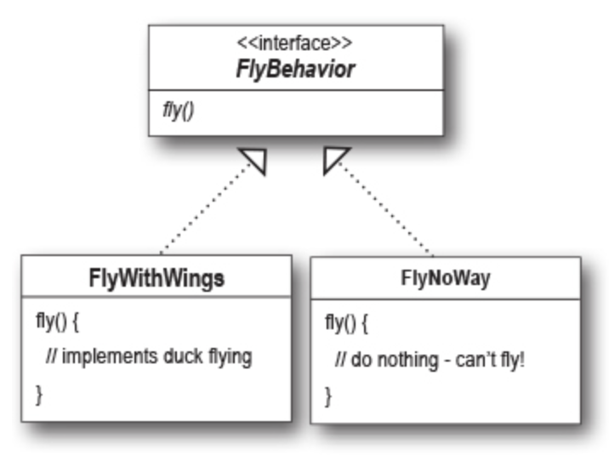
Designing the Duck Behaviors
We’ll make a set of classes whose entire reason for living is to represent a behavior (for example, “squeaking”), and it’s the behavior class, rather than the Duck class, that will implement the behavior interface.
Duck subclasses will use a behavior represented by an interface (FlyBehavior and QuackBehavior).
The actual implementation of the behavior won’t be locked into the Duck subclass.

Slide 17
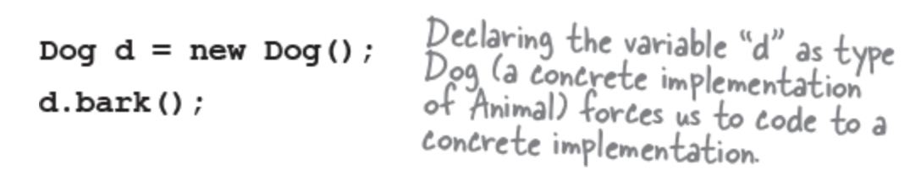
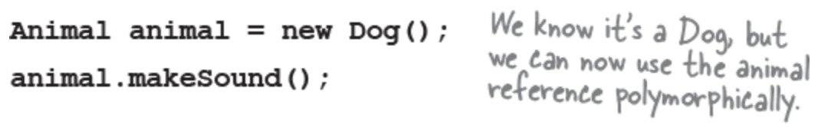
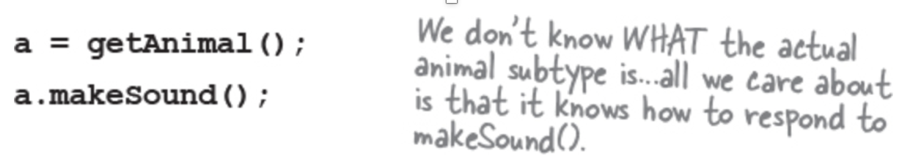
Programming to an implementation vs
programming to an interface/supertype
Programming to an implementation would be:
But programming to an interface/supertype would be:
Even better, rather than hardcoding the instantiation of the subtype (like new Dog()) into the code, assign the concrete implementation object at runtime:

Slide 18
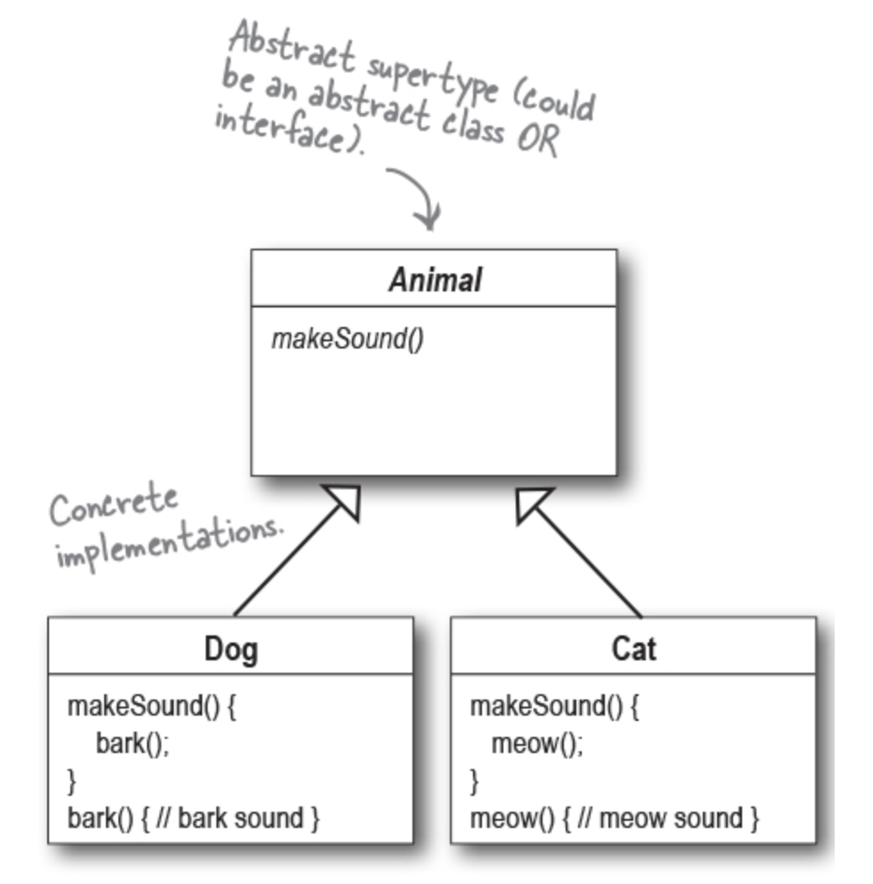

Slide 19
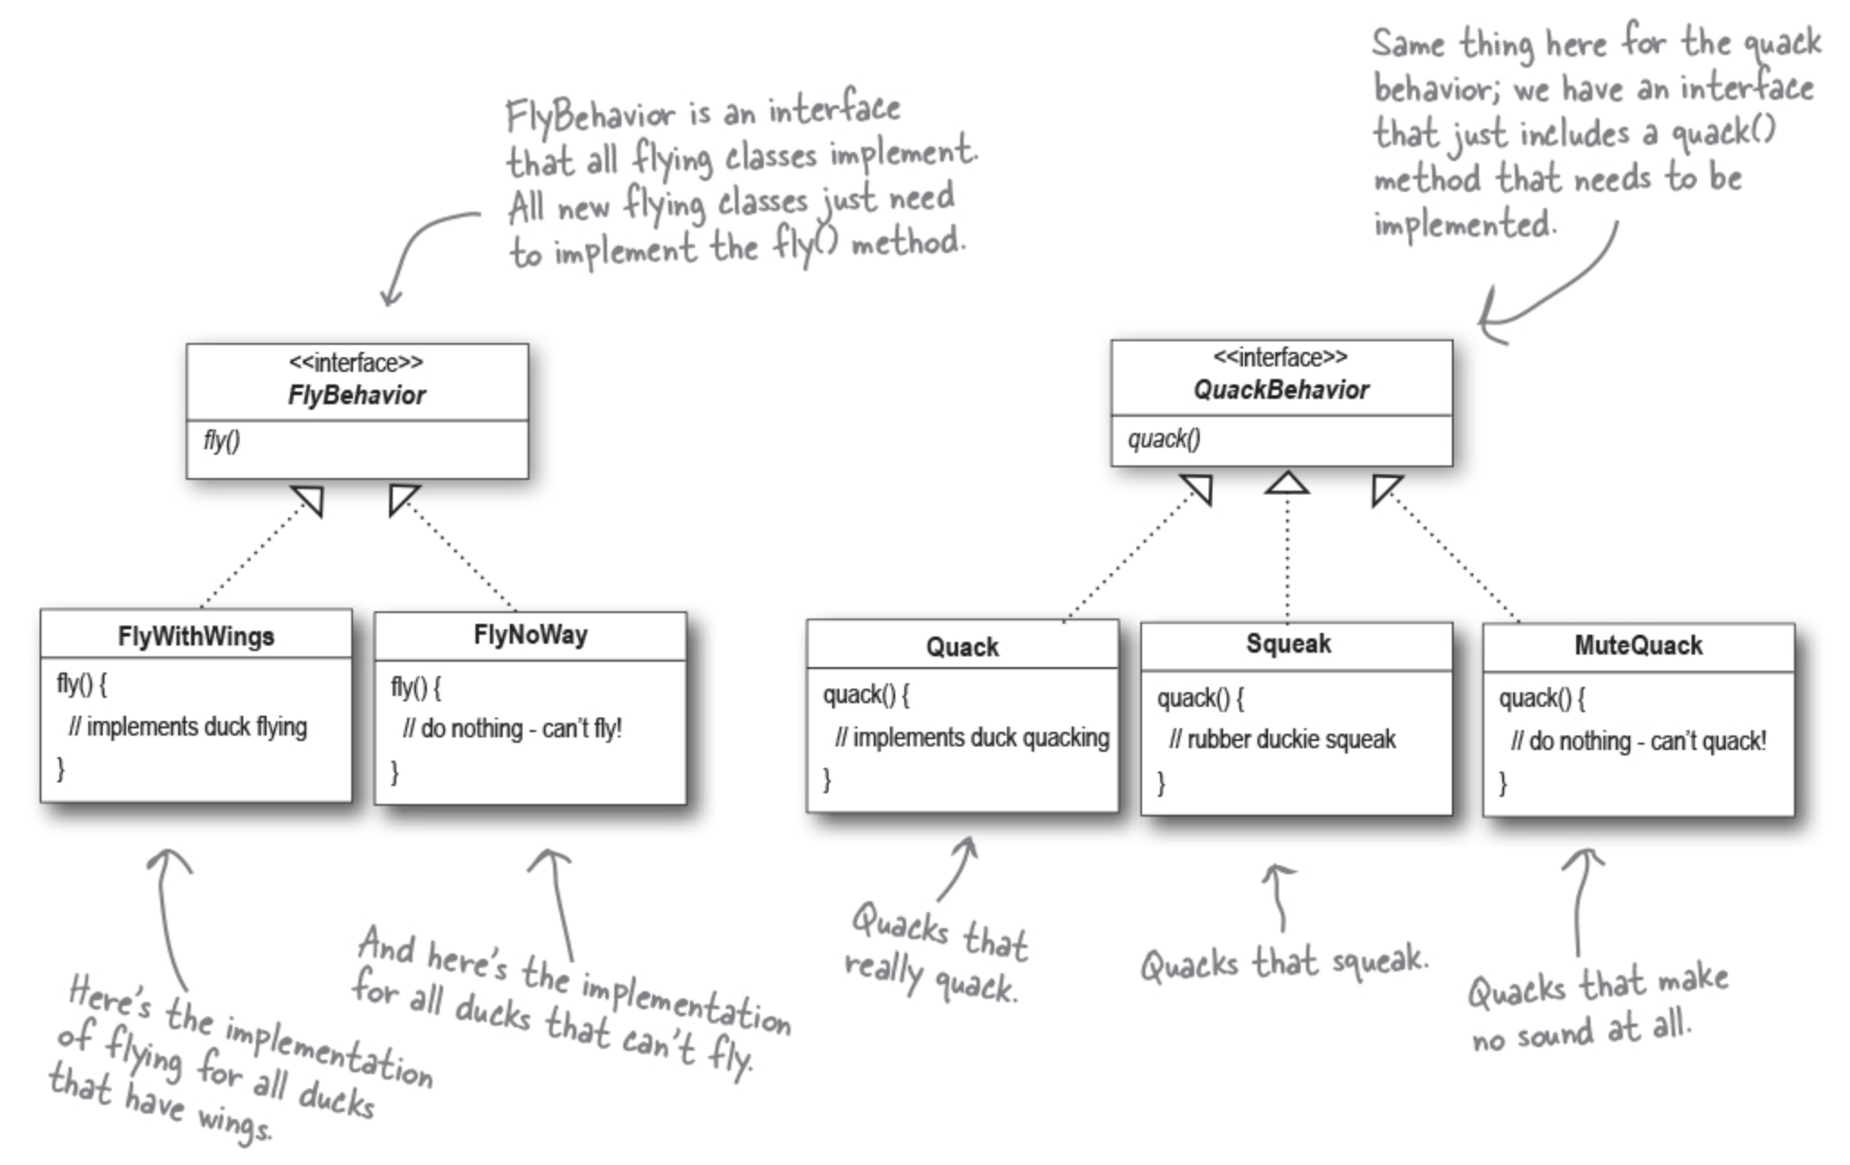
Implementing the Duck Behaviors
Two interfaces, FlyBehavior and QuackBehavior, along with the corresponding classes that implement each concrete behavior:

Slide 20
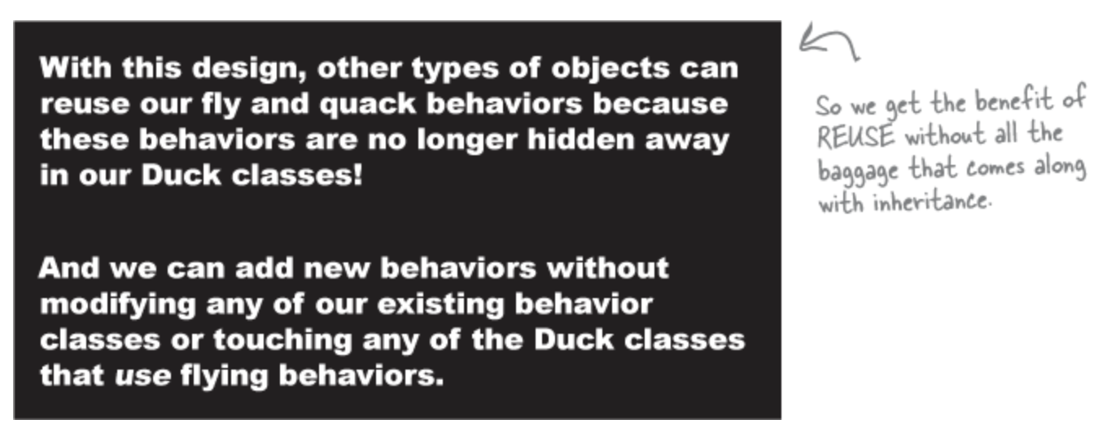
Implementing the Duck Behaviors

Slide 21
Integrating the Duck Behaviors
A Duck will now delegate its flying and quacking behaviors, instead of using quacking and flying methods defined in the Duck class (or subclass). How?
First, we’ll add two instance variables of type FlyBehavior and QuackBehavior.
Each concrete duck object will assign to those variables a specific behavior at runtime, like FlyWithWings for flying and Squeak for quacking.
We’ll also remove the fly() and quack() methods from the Duck class (and any subclasses) because we’ve moved this behavior out into the FlyBehavior and QuackBehavior classes.
We’ll replace fly() and quack() in the Duck class with two similar methods, called performFly() and performQuack(); you’ll see how they work next.

Slide 22
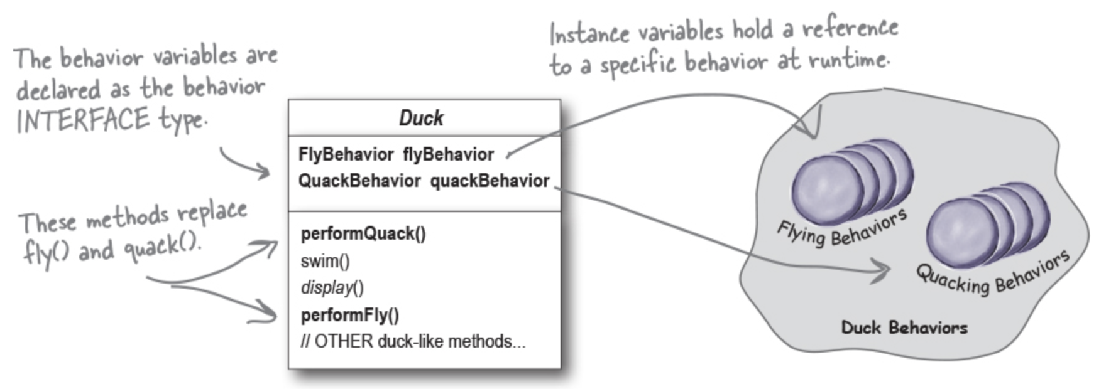
Integrating the Duck Behaviors

Slide 23
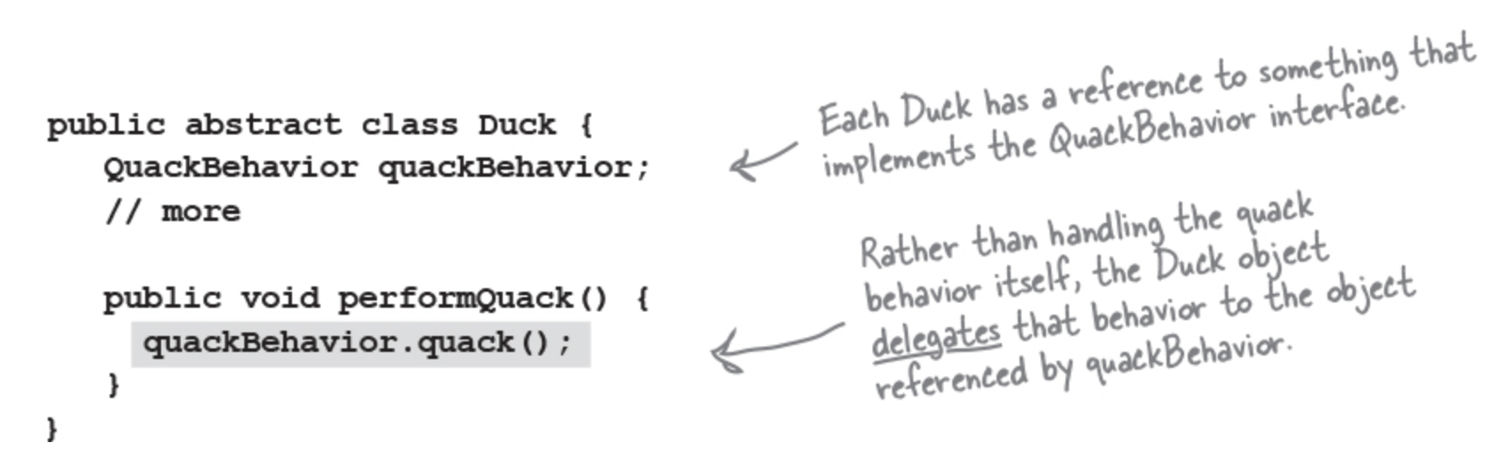
Integrating the Duck Behaviors
Now we implement performQuack():
To perform the quack, a Duck just asks the object that is referenced by quackBehavior to quack for it.
In this part of the code, we don’t care what kind of object the concrete Duck is, all we care about is that it knows how to quack()!

Slide 24
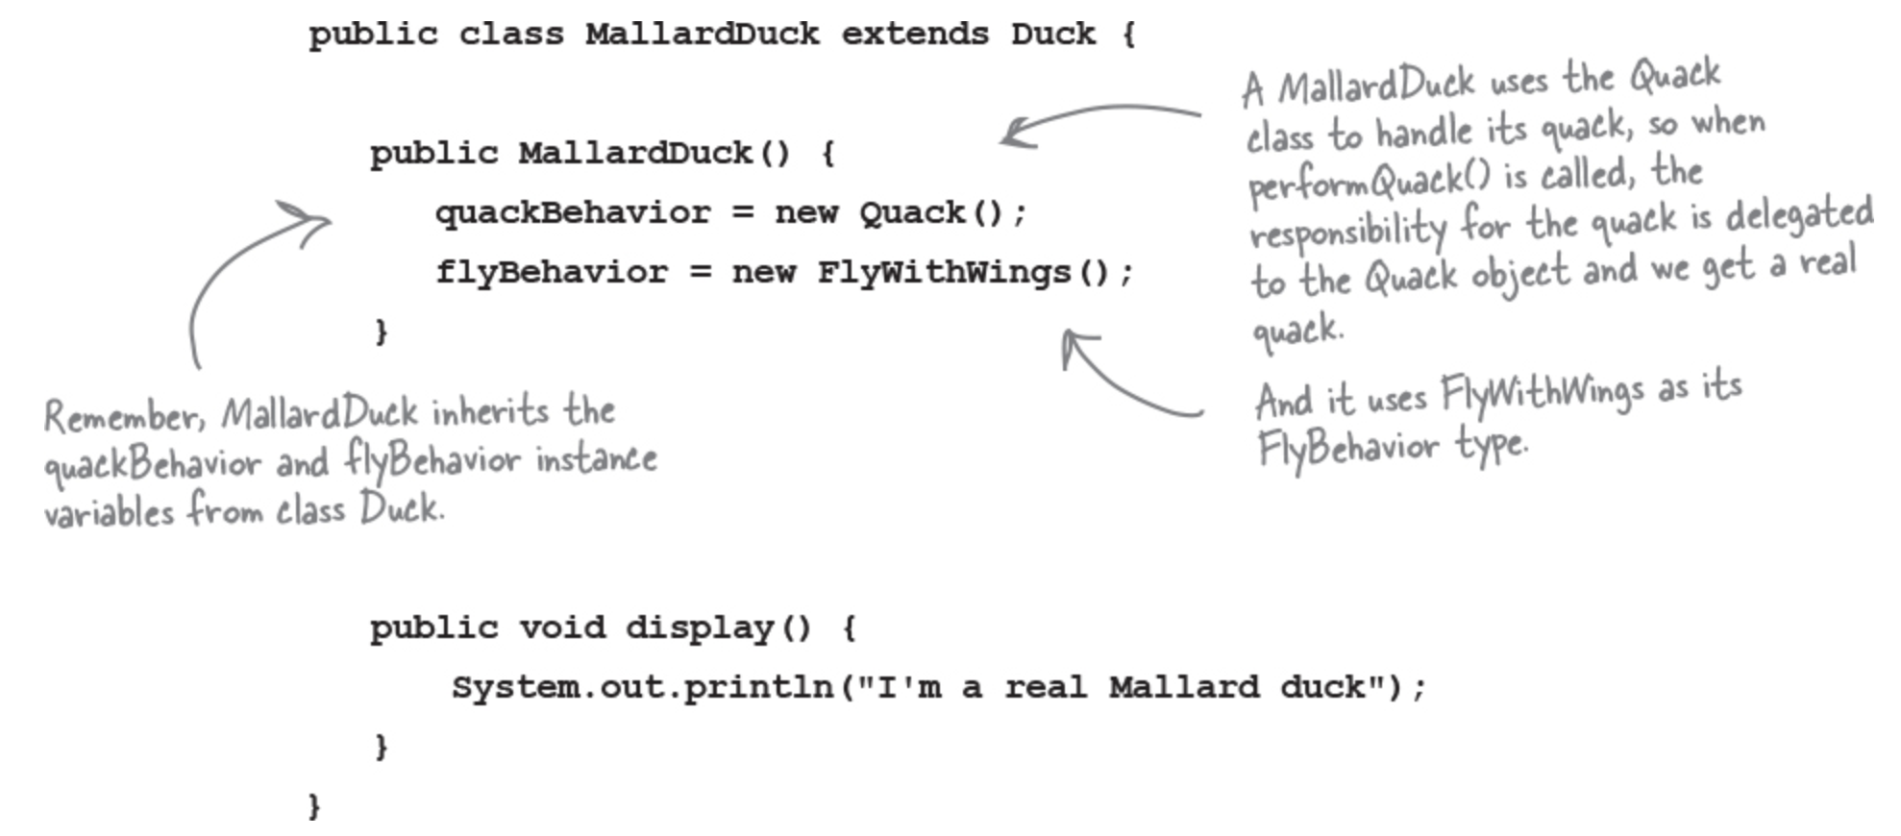
More integration...
Now, how the flyBehavior and quackBehavior instance variables are set? Let’s take a look at the MallardDuck class:
MallardDuck’s quack is a real live duck quack, not a squeak and not a mute quack.
When a MallardDuck is instantiated, its constructor initializes the MallardDuck’s inherited quackBehavior instance variable to a new instance of type Quack (a QuackBehavior concrete implementation class).
And the same is true for the duck’s flying behavior—the MallardDuck’s constructor initializes the inherited flyBehavior instance variable with an instance of type FlyWithWings (a FlyBehavior concrete implementation class).

Slide 25
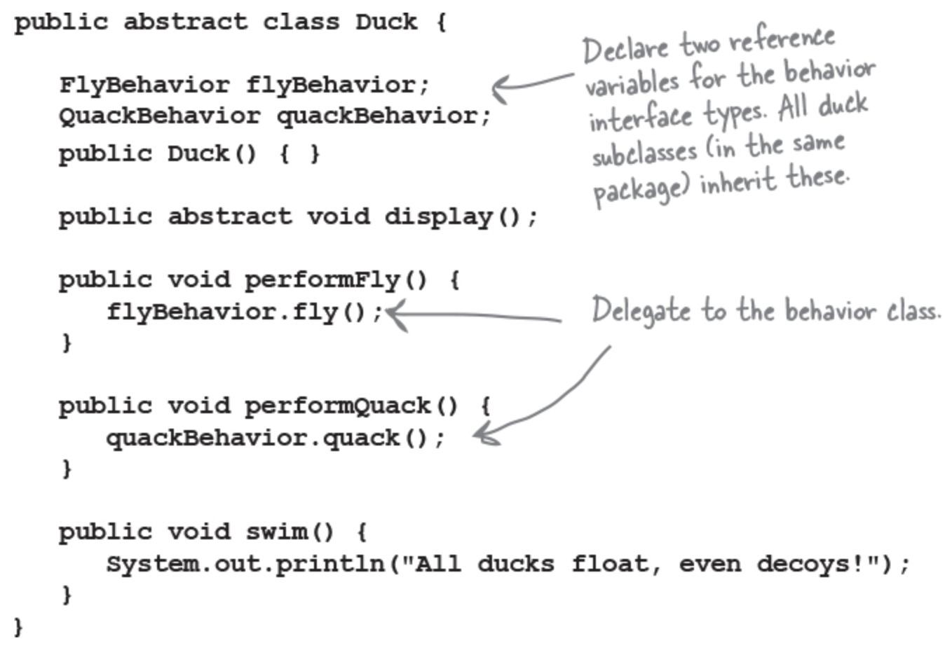
Testing the Duck code
MallardDuck.java

Slide 26
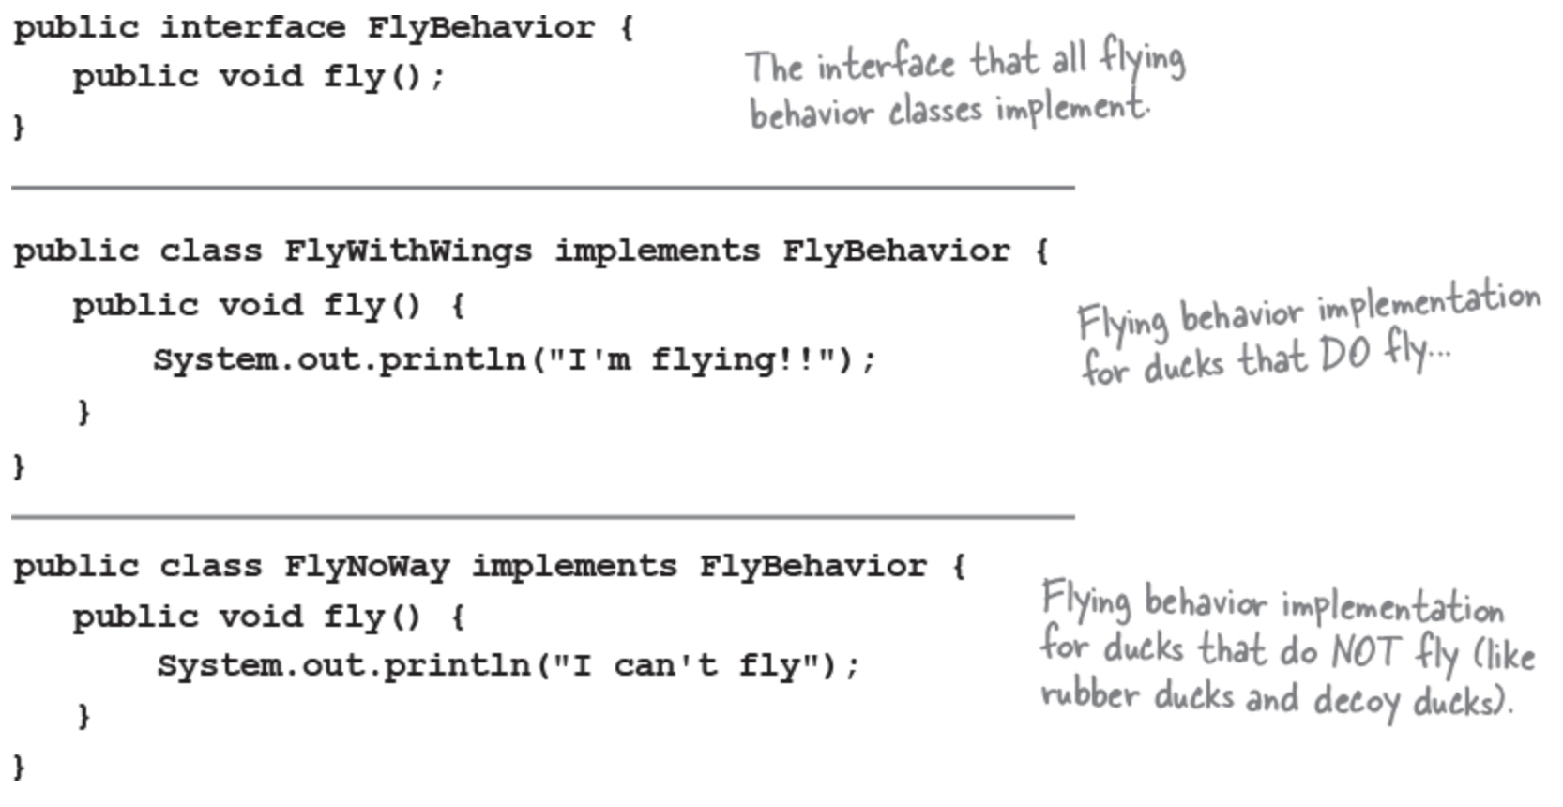
Testing the Duck code
FlyBehavior.java, FlyWithWings.java, and FlyNoWay.java

Slide 27
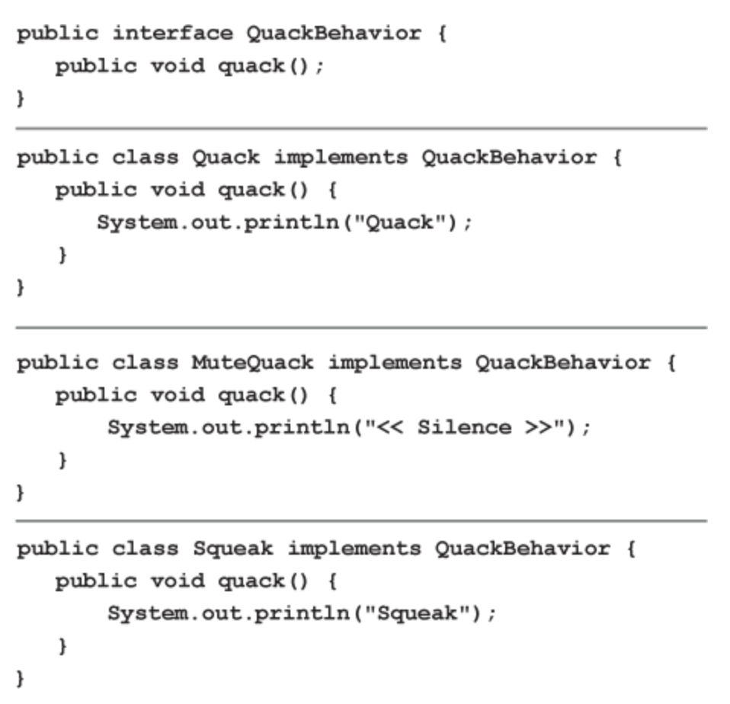
Testing the Duck code
QuackBehavior.java, Quack.java, MuteQuack.java, and Squeak.java

Slide 28
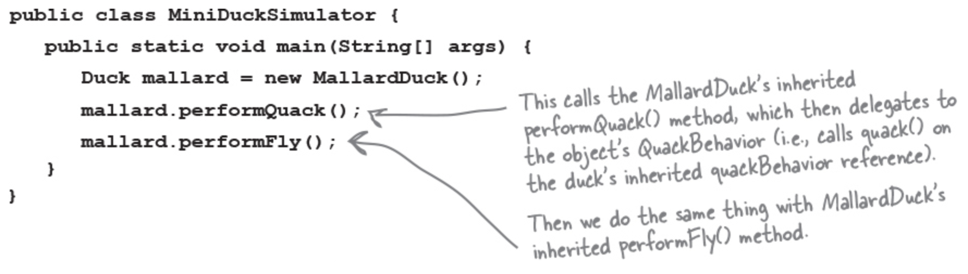
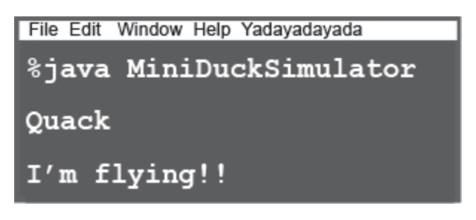
Testing the Duck code
test class: MiniDuckSimulator.java
Run the code

Slide 29
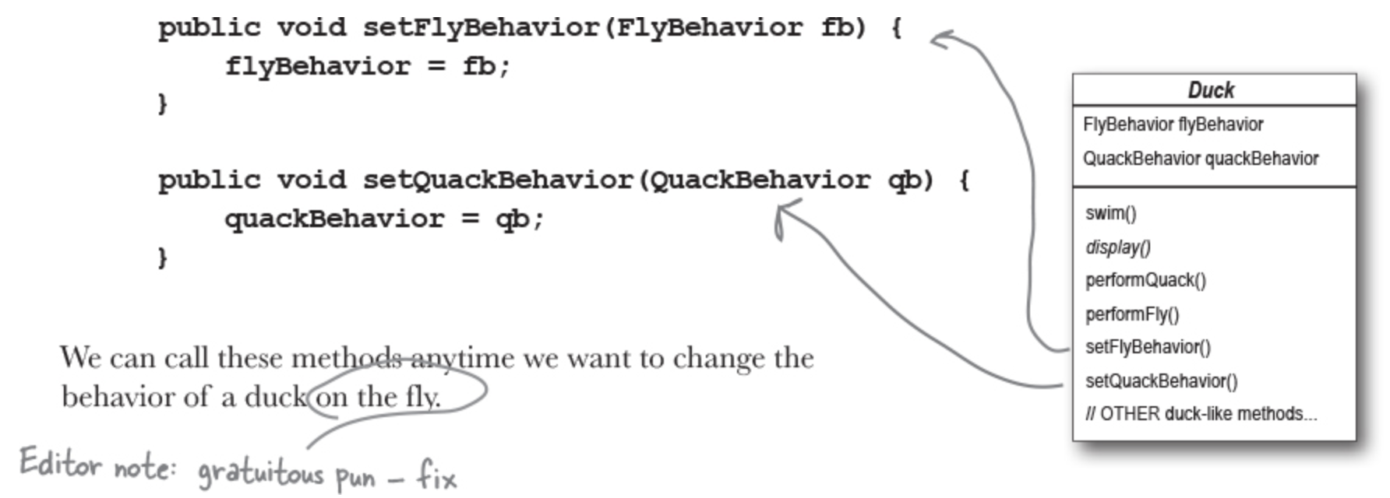
Setting behavior dynamically
Imagine we want to set the duck’s behavior type through a setter method on the Duck class, rather than by instantiating it in the duck’s constructor.
Add two new methods to the Duck class:

Slide 30
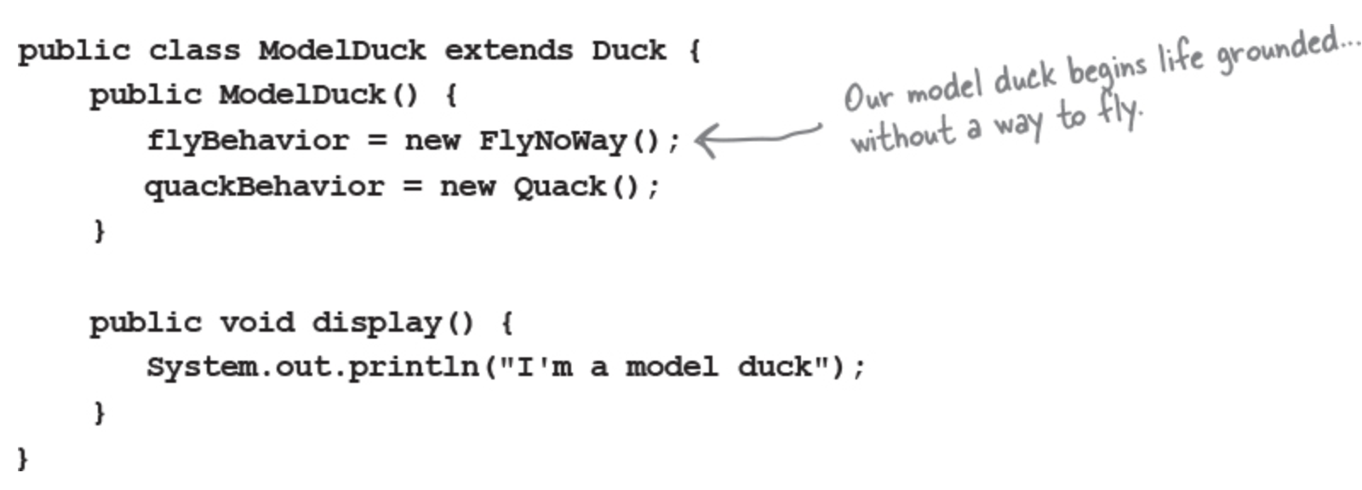
Setting behavior dynamically
Make a new Duck type (ModelDuck.java)

Slide 31
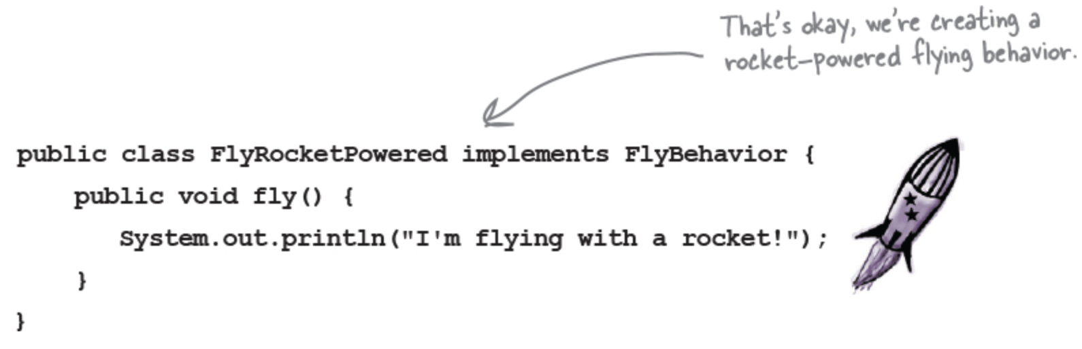
Setting behavior dynamically
Make a new FlyBehavior type (FlyRocketPowered.java)

Slide 32
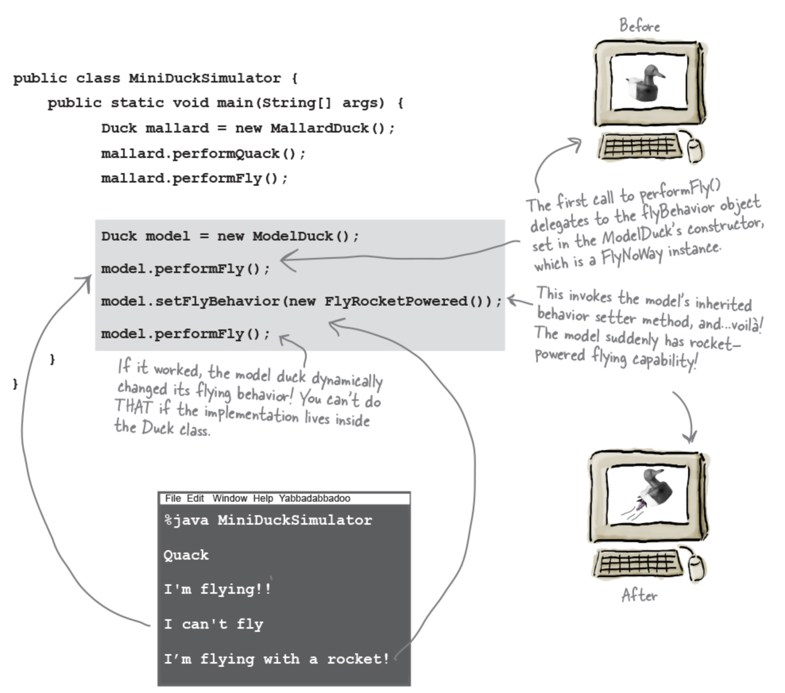
Setting behavior dynamically
Change the test class (MiniDuckSimulator.java), add the ModelDuck, and make the ModelDuck rocket-enabled, and Run it!
To change a duck’s behavior at runtime, just call the duck’s setter method for that behavior.

Slide 33
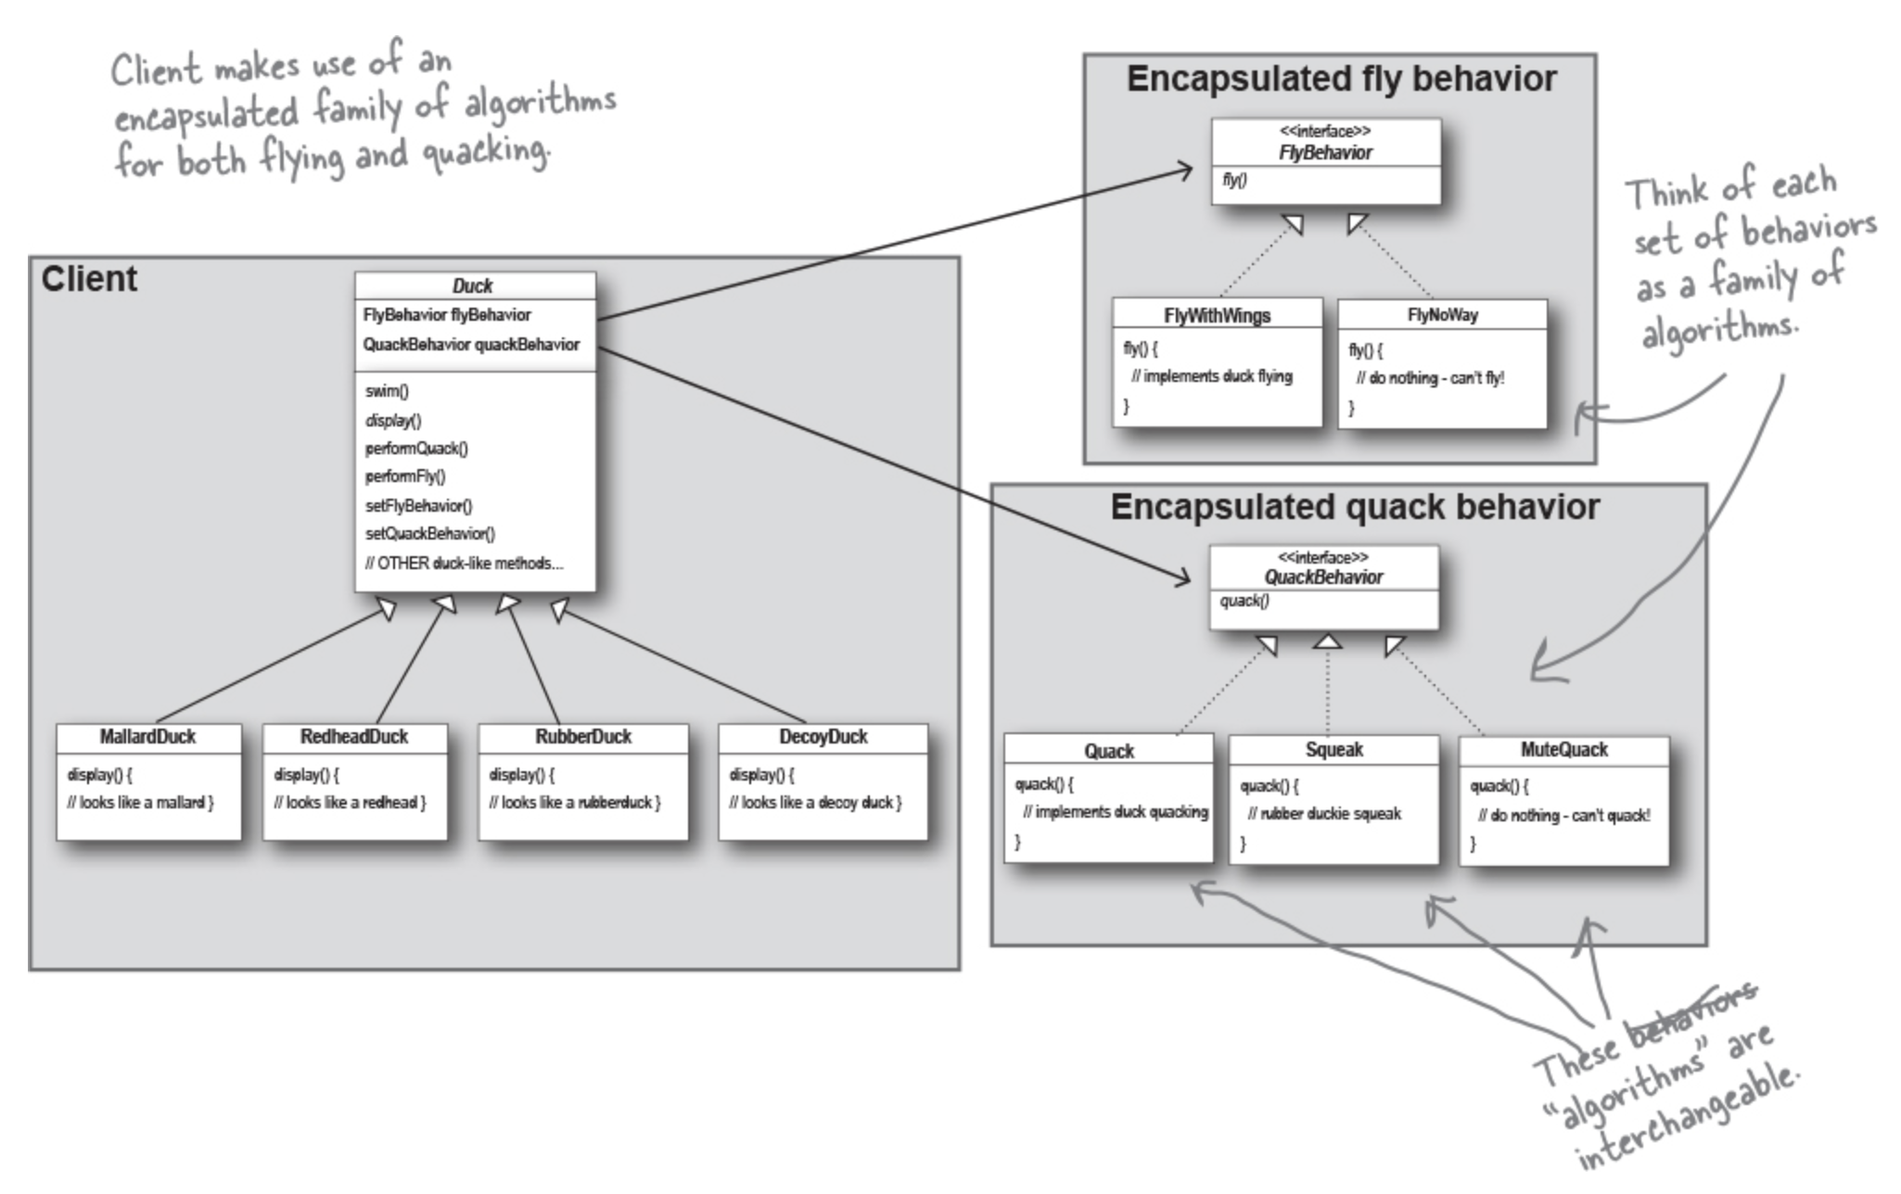
The Big Picture on encapsulated behaviors
Ducks extending Duck, fly behaviors implementing FlyBehavior, and quack behaviors implementing QuackBehavior.

Slide 34

HAS-A can be better than IS-A
The HAS-A relationship is an interesting one: each duck has a FlyBehavior and a QuackBehavior to which it delegates flying and quacking.
When you put two classes together like this, you’re using composition. Instead of inheriting their behavior, the ducks get their behavior by being composed with the right behavior object.
This is an important technique; in fact, it is the basis of our third design principle:
Change behavior at runtime

Slide 35
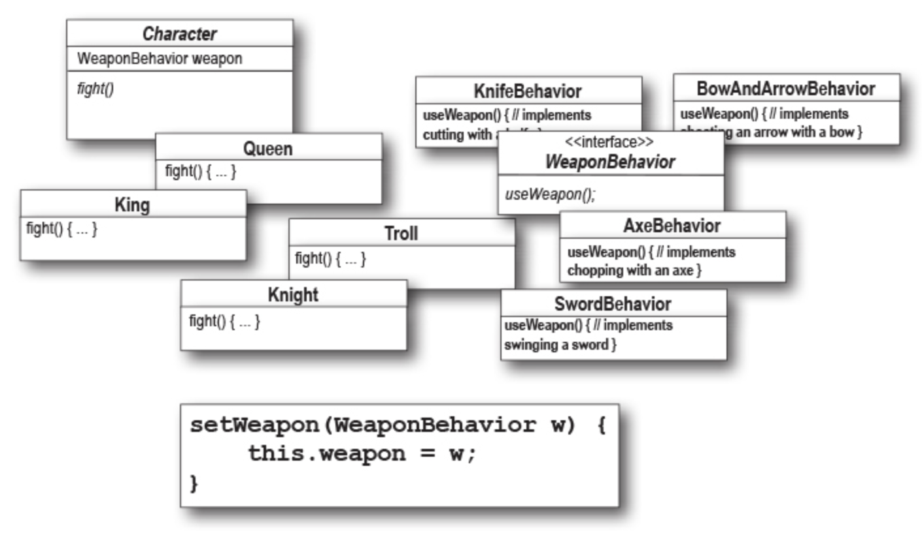
Design Puzzle
Below is a mess of classes and interfaces for an action-adventure game.
Classes for game characters along with classes for weapon behaviors the characters can use in the game.
Each character can make use of one weapon at a time but can change weapons at any time during the game. Your job is to sort it all out...

Slide 36
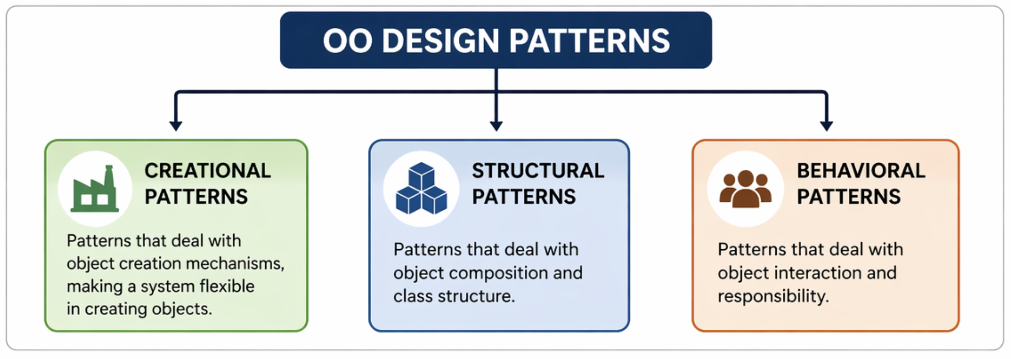

Slide 37
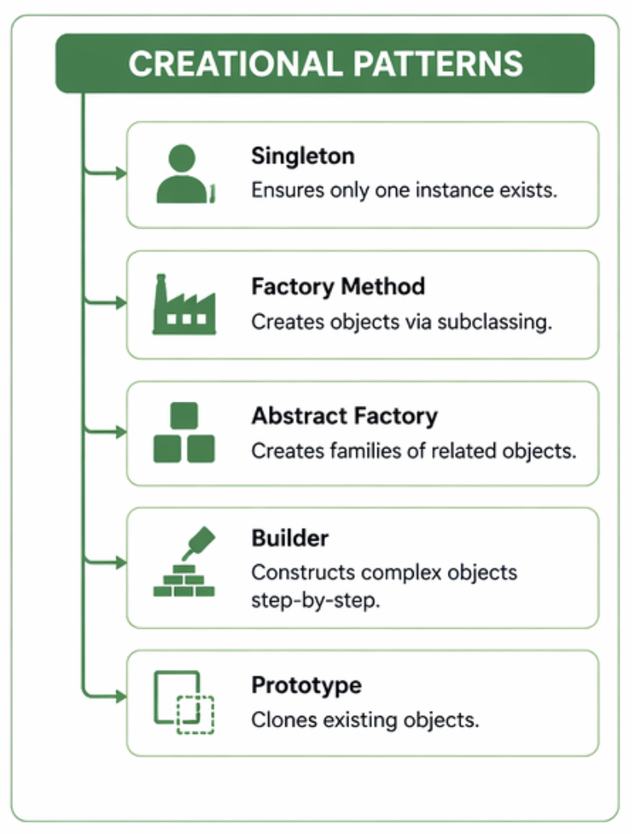

Slide 38
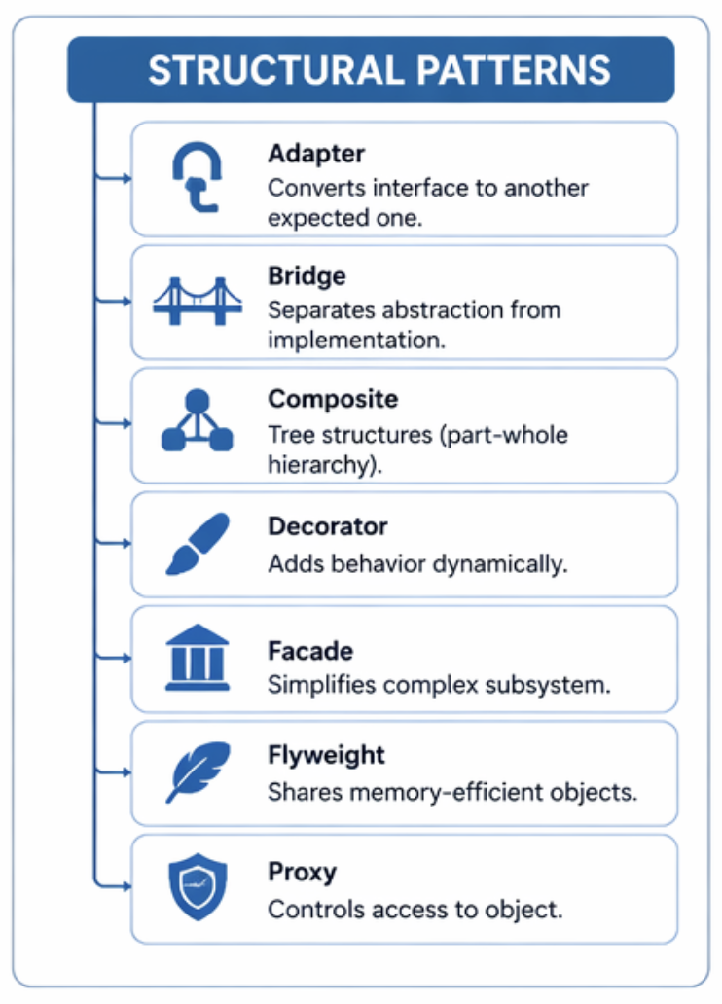

Slide 39
